Slide 1
Assessment & Corrective Work In Athletic Development Programming
Bill Hartman
Co-owner Indianapolis Fitness and Sports Training
IYCA Summit 2012

Slide 2
Thank You
IYCA
Thanks to the speakers
Thanks to all of you

Slide 3
The Corrective Process
Assess
Identify any limiting factors in performance
Determine the corrective strategy
Apply the corrective strategy
Re-assess
Apply new corrective action or integrate
Repeat as necessary
Notes:
Performance = injury prevention

Slide 4
Components of Assessment
Posture/Alignment
Foundational Movement
Force production
Energy production
Activity/sport specific skill
Notes:
Performance and injury prevention is a multifactoral process therefore there must be a full spectrum of testing

Slide 5
Assessment Rule #1
Everything is an assessment
  Observe the athlete in various environments
  Can be an effective component of the assessment process
  Less standardized
  Requires a much stronger understanding of performance
Notes:
Pt. walks back
watch a client exercise
For some this is their only assessment

Slide 6
Assessment Rule #2
Qualify Gross/Foundational Movements First
  Establishes a standard of alignment and movement
  Identifies “Red Flags”
  Allows before/after comparisons to test corrective strategy
Notes:
Spend most time on this because its easier to see and work with

Slide 7
Gross Movements
Standard/Baseline of Movement
  Squat – symmetry, depth, lumbar flexion, joints
  Lunge – medial/lateral knee, trunk position
  Jump/landing – quad/hip dominant, M/L control
  Step-up – QL substitution, hip stability
  Gait - ankle, hip, lumbar spine, rotation, head
  Push-up/Plank – trunk and scapular stability
  Breathing pattern
  Sport-specific, activity specific
Notes:
We’ll use these tomorrow when we actually get to assess each other

Slide 8
Assessment Rule #3
Perform deloaded/isolated testing based on “Red Flags” and components of foundational movements
  Performing deloaded movement or breaking down movements into components allows determination of true limiting factor
  May include special tests and breathing pattern in isolation
Notes:
Gait premature heel raise during gait

Slide 9
Isolated Movement
Key areas
  Neck flexion, extension, rotation
  Shoulder abduction, horizontal adduction, traditional IR and ER active/passive
  Thoracic spine extension, rotation standing, and seated
  Lumbar spine full flexion or extension deloaded
  Hip flexion, extension, hip abduction, IR and ER active/passive
  Knee equal extension
  Ankle dorsiflexion passive and active
  Great toe extension
  Breathing pattern

Slide 10
Assessment Rule #4
Assess at speed, under external load, and in the presence of fatigue AFTER assessing at body weight and in isolation
  Things change with circumstances
  It may not be safe to proceed
  Power, strength, and energy systems fall into this category

Slide 11
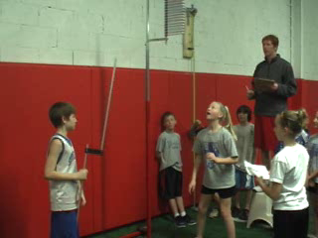

Slide 12
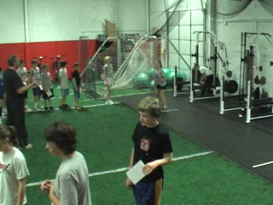

Slide 13
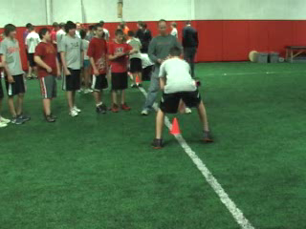

Slide 14
Assessment Rule #5
Observe the athlete performing their sport
  Most specific performance parameters
  Note changes in movement, technique, strategy
  Requires understanding of the sport
Notes:
Baseball pitcher falling off mound
I used to train a lot of golfers

Slide 15
Specificity
If there is a generality of muscle function then strong relationships would exist between various measures of function for the same muscle(s), independent of the test contraction, mode or velocity…The results of this study demonstrated that a generality of muscle function did not exist and that modality specific results were observed.
Ref: Daniel Baker, Greg Wilson and Bob Carlyon. Generality versus specificity: a comparison of dynamic and isometric measures of strength and speed-strength. Volume 68(4): 350-355. July 1994.

Slide 16
The Corrective Process
Assess
Identify any limiting factors in performance
Determine the corrective strategy
Apply the corrective strategy
Re-assess
Apply new corrective action or integrate
Repeat as necessary
Notes:
Performance = injury prevention

Slide 17
Corrective Rule #1
Prioritize restoration of movement
  Normal proprioception demands full ROM
  Normal motor control requires normal proprioception
  May restore strength via improved position
  Glute activation?
Notes:
Example lumbar flexion deficit
hip IR or extension deficit

Slide 18
Corrective Rule #2
Corrective programming should address dysfunction in the following sequence:
  Physiological 1st
  Biomechanical 2nd
  Neurological 3rd

Slide 19
Types of Dysfunction
Physiological (local issuses)
  Tissue length, stiffness, muscle strength/imbalance, right vs. left symmetry, breathing
Biomechanical (kinetic chain)
  Joint function and relationships between structures
Neuromuscular (central nervous system)
  Motor control, proprioception, reflexes
Notes:
fibula

Slide 20
Corrective Rule #3
Start exercise progressions under demands where the athlete can be successful.
  Several exercises may be designed for the same general result but one may be a better choice
  Progress posture, speed, load, fatigue status, etc. as able

Slide 21
Corrective Rule #4
Organize corrective programming within the components of your full training program
  Create problems list
  Select strategy within program

Slide 22
Potential Fixes
Manual Therapies
Self-myofascial release
Stretching
Strength
Stability
Mobilization w/movement
Feldenkrais
PNF
EQI’s/Isometrics
EST

Slide 23
Example Corrective Grid
Problem | STM | Mobility | Activation | Explosive | Strength | EST
Dorsiflexion | Foot Calf | Wall mobe |  |  | squat
breathing |  | Bent Hang | 3.5 month
Hip extension | TFL RF | Quad stretch | Bridge progression |  | Pull-through
aerobic |  |  |  |  | Tempo squat | HICT

Slide 24
Corrective Rule #5
Apply the corrective strategy
Re-assess
Apply new corrective action or integrate
Repeat as necessary
Daily Monitoring of performance

Slide 25
Daily Monitoring
Observation
Resting HR
HRV
Grip strength
Vertical Jump
Rating of perceived exertion
Rating of technique

Slide 26
IFAST University
Summer Session This July
Learn the complete IFAST Assessment
IFASTonline.com
BillHartman.net

Slide 27
Questions, comment, gripes, or complaints

Slide 28
Gross Movements

